Slide 1

Introduction
Anatoly Langer
MD, FACC, FRCP(c), MSc.
Cardiologist, Professor of Medicine
University of Toronto
Chair, Canadian Heart Research Centre
PI, GOAL International Program

Slide 2


GOAL International
Guidelines Oriented Approach to Lipid lowering International
STEERING COMMITTEE
Anatoly Langer, MD (Chair)
Khalid Al Faraidy, MD (Saudi Arabia)
Mousa Akbar, MD (Kuwait)
4. Wael Almahmeed, MD (Abu Dhabi)
5. Marco Antonio Alcocer-Gamba, MD (Mexico)
6. Otavio Berwanger, MD (Brazil)
COORDINATING CENTRE
Canadian Heart Research Centre, Toronto, Canada
INVESTIGATOR SPONSORED STUDY
Anatoly Langer, MD, M.Sc, FRCP(C,) FACC
 416-999-6264; Fax 866-562-9769
E-mail: langera@chrc.net
SUPPORT Amgen Inc.

Slide 3
Agenda
The need for lipid lowering beyond statin therapy
www.goalinternational.info/beyondstatin
The data behind PCSK9 inhibitors
www.goalinternational.info/PCSK9i
Real-world data from the GOAL Canada Program
www.goalinternational.info/goalcanada
GOAL International
www.goalinternational/protocol
www.goalinternational.info/ecrf

Slide 4
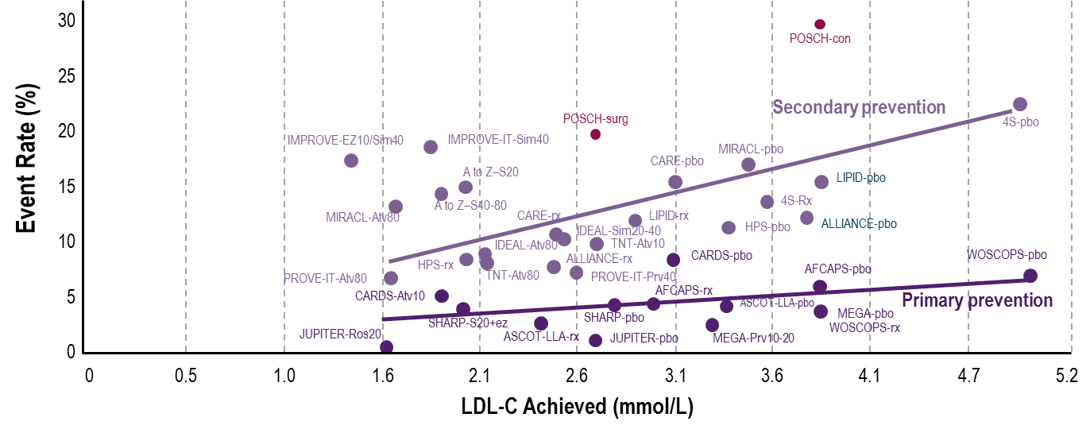

Linear Relationship With Lowering of LDL-C and Reduced CV Events in CV Outcomes Statin Trials
Major Lipid Trials: LDL-C Levels vs. Rates of Coronary Events
Similar associations between LDL-C lowering and reduction of major coronary events were seen in both primary prevention and secondary prevention trials
Note: Line for secondary prevention studies excludes IMPROVE-IT. IMPROVE-IT reflects 7-year rate of major coronary events (nonfatal MI or CHD) and mean LDL-C achieved at year 1.
CV = cardiovascular; LDL-C = low-density lipoprotein cholesterol.
1. Raymond C, et al. Cleve Clin J Med. 2014;81:11-19. 2. Cannon CP, et al. N Engl J Med. 2015;372:2387-2397.
Notes:
Notes

Slide 5
Reduction in CV Events is Proportional to LDL-C Reduction at 1 Year
A prospective meta-analysis of data from 90,056 individuals from 14 trials of statins
A 1 mmol/L reduction in LDL-C was associated with a…
23% reduction in major coronary events
21% reduction in major vascular events
50
50
40
40
30
30
Proportional reduction in event rate (%±SE)
Proportional reduction in event rate (%±SE)
20
20
10
10
0
0
0.5 (19)
1.0 (38)
1.5 (58)
2.0 (77)
0.5 (19)
1.0 (38)
1.5 (58)
2.0 (77)
-10
-10
Reduction in LDL-C mmol/L (mg/dL)
Reduction in LDL-C mmol/L (mg/dL)
Adapted from Baigent C, et al, Cholesterol Treatment Trialists’ (CTT) Collaborators. Lancet 2005;366:1267–1278.

Slide 6
No Evidence for a Lower LDL-C Limit in Reducing Major CV Events
TNT¹
Rate of major CV events*
JUPITER²
Risk of primary endpoint†
PROVE-IT³
Risk of primary endpoint‡
Placebo
> 2.1– 2.6
Referent
≥ 2.7
Not < 1.3 vs placebo
0.76 (0.57–1.00)
2.3 - < 2.7
> 1.6–2.1
0.80 (0.59, 1.07)
2.0 - < 2.3
Achieved LDL-C (mmol/L)
< 1.3 vs placebo
0.35 (0.25–0.49)
> 1.0–1.6
0.67 (0.50, 0.92)
1.7 - < 2.0
P for trend across LDL-C < 0.0001
< 1.3 vs not < 1.3
0.39 (0.26–0.59)
< 1.7
≤ 1.0
0.61 (0.40, 0.91)
0
2
4
6
8
10
12
14
0.1
1
10
0
1
2
% of Patients With Major CV Events
Lower LDL-C Better
Higher LDL-C Better
Lower LDL-C Better
Higher LDL-C Better
*Major CV events for TNT trial were defined as defined as CHD death, nonfatal non-procedured–related MI, resuscitated cardiac arrest, and fatal or nonfatal stroke. †JUPITER primary endpoint was composite of MI, stroke, arterial revascularization, unstable angina, or confirmed death from CV causes. ‡PROVE-IT primary endpoint was composite of death, MI, stroke, revascularization and unstable angina requiring hospital admission.
CHD = coronary heart disease; CV = cardiovascular; LDL-C = low-density lipoprotein cholesterol, MI = myocardial infarction.
LaRosa JC, et al. Am J Cardiol. 2007;100:747-752.
Hsia J, et al. J Am Coll Cardiol. 2011;57:1666-1675.
Wiviott et al. J Am Coll Cardiol. 2005;46:1411-1416.

Slide 7
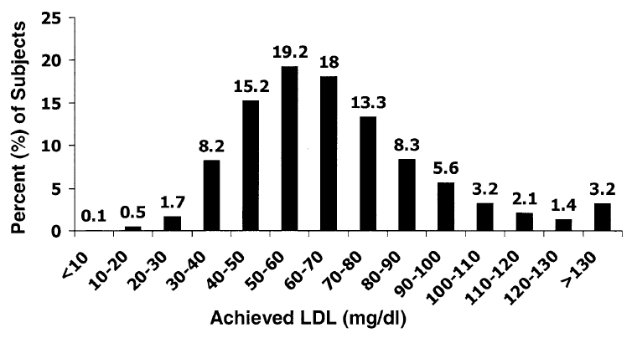
Proportion of Patients On an Intensive Statin (Dose) Reaching LDL Target
Distribution of 4-month LDL levels Among Patients Treated with Intensive Statin Therapy (Atorvastatin 80 mg)
37.1% of patients
≥70 mg/dl (1.81 mmol/L)
Wiviott et al for the PROVE IT-TIMI 22 Investigators J Am Coll Cardiol 2005;46:1411-16)

Slide 8

On-Statin LDL-C Levels and Risk for Major Cardiovascular Events
There is often a need for LDL-C reduction beyond statin therapy
1.00
40
0.75
30
In clinical trials, even amongst those patients on a similar statin dosage, those who had the lowest LDL-C levels had the lowest CV event rates
HR for Major CV Events (―)
Percent of Patients ( %)
0.50
20
0.25
10
0
1.3
2.6
3.9
5.2
6.5
Achieved On-statin LDL Levels
Meta-analysis of 8 statin trials (N=38,153):
>40% did not reach LDL-C target (<1.8 mmol/L) on high dose statin
CV, cardiovascular; CVD, cardiovascular disease; HR, hazard ratio.
Boekholdt SM et al. J Am Coll Cardiol. 2014;64:485-494.

Slide 9

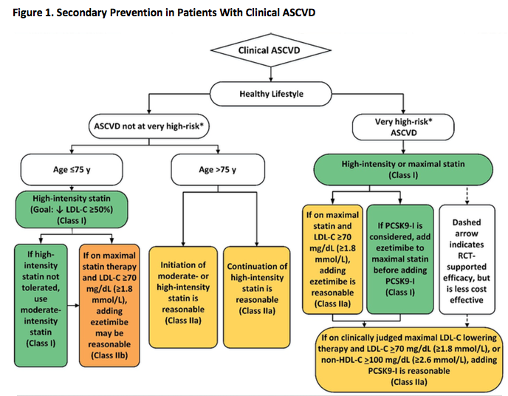
2018 AHA/ACC Lipid Guidelines
Grundy et al Circ 2018

Slide 10
2017 UPDATE OF ESC/EAS Task Force for PCSK9i
ACS, acute coronary syndrome; ASCVD, atherosclerotic cardiovascular disease; CAD, coronary artery disease; PAD, peripheral arterial disease; PCSK9i, proprotein convertase subtilisin/kexin type 9 inhibitor Landmesser U, et al. Eur Heart J. 2017

Slide 11
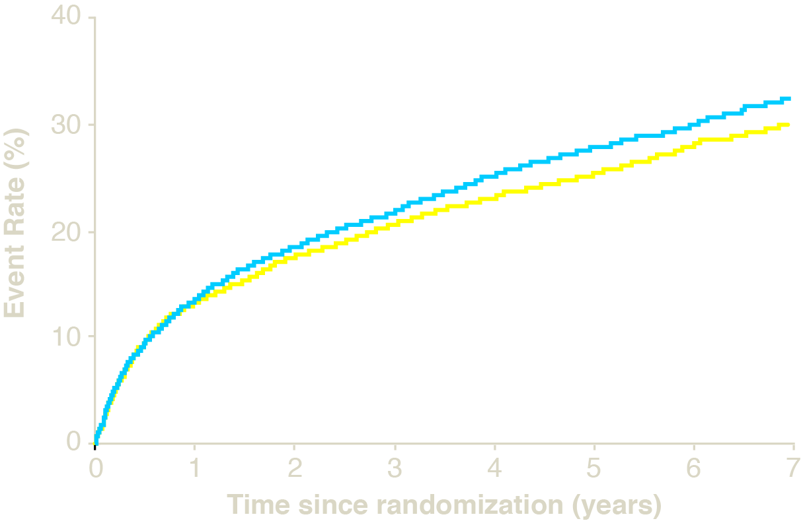
Primary Endpoint*
*Cardiovascular death, MI, documented unstable angina requiring rehospitalization, coronary revascularization (≥30 days), or stroke
Baseline mean 2.4 mmol/L
34.7%
2742 events
Simvastatin
1.8 mmol/L
Simva+Ezetimibe
1.4 mmol/L
Simvastatin
32.7%
2572 events
Ezetimibe/
Simvastatin
HR 0.94 (0.89, 0.99)
p=0.016
NNT= 50
Cannon et al N Engl J Med 2015;372:2387-97

Slide 12
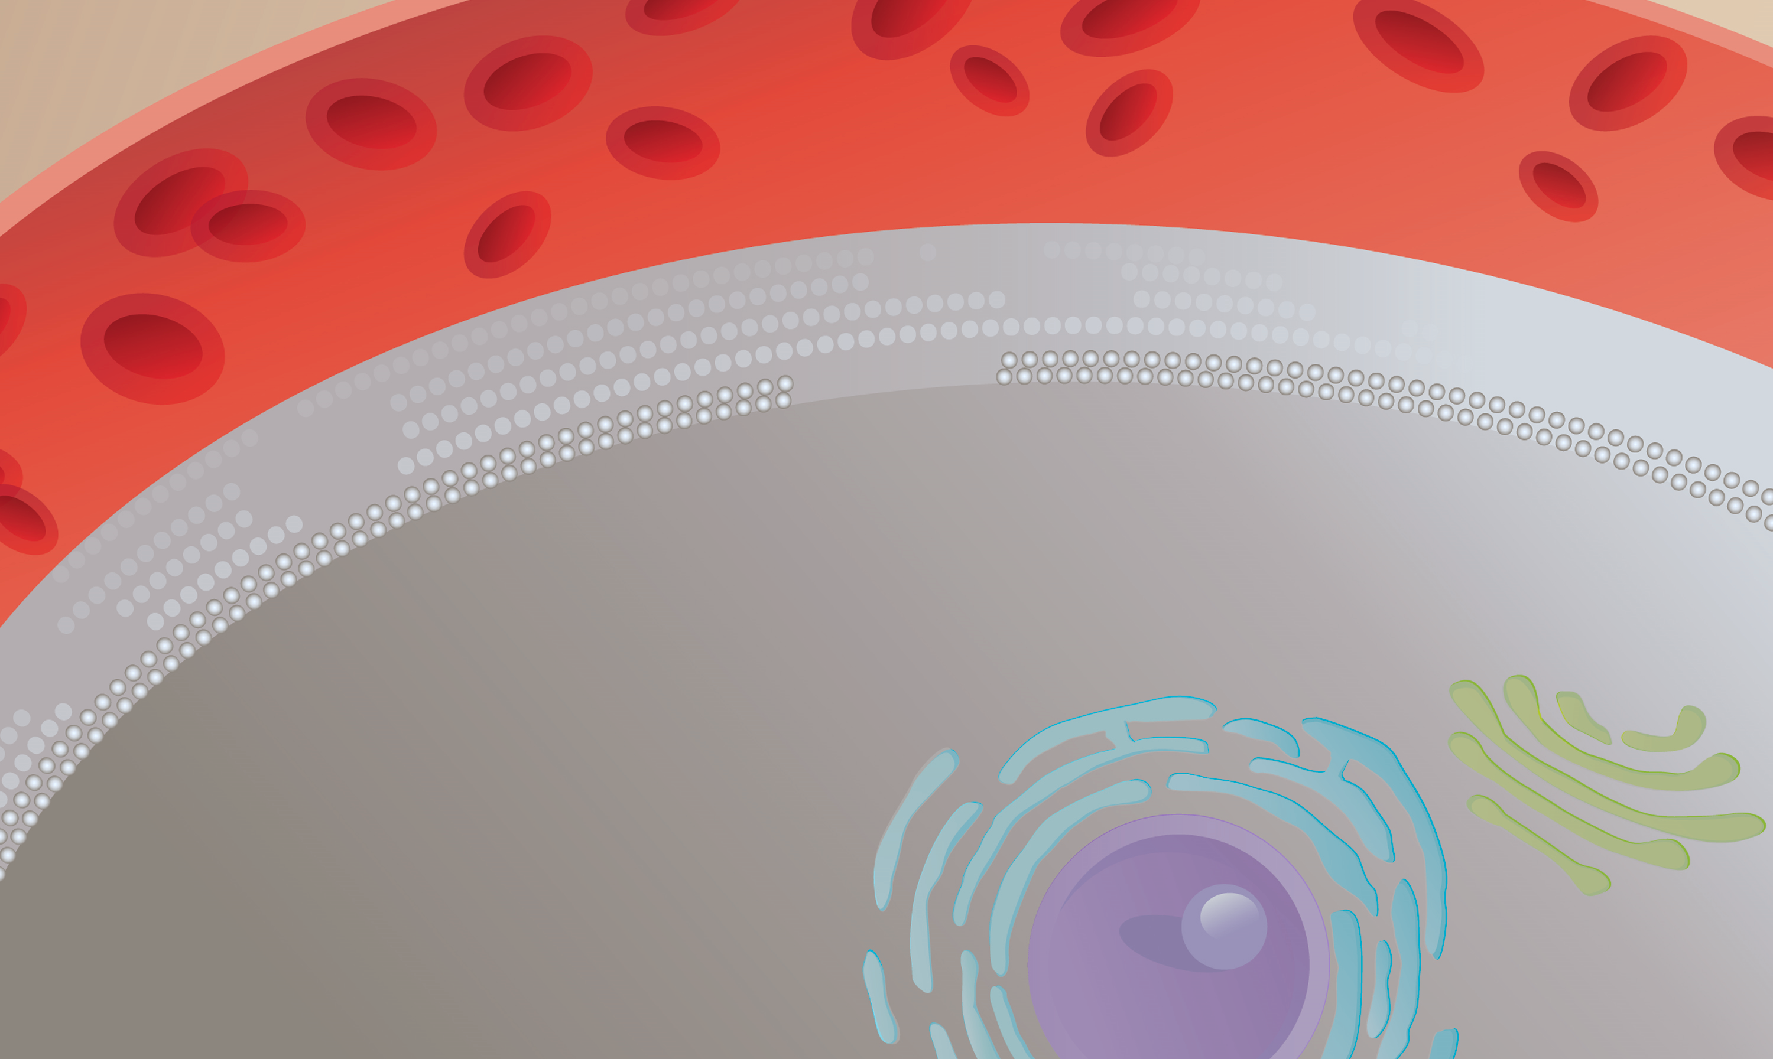
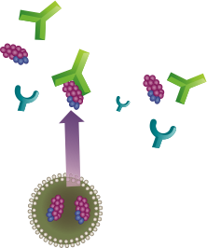

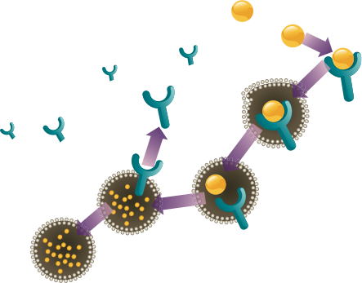

Blocking PCSK9 Activity Inhibits Intracellular Degradation of LDL-R
PCSK9 MAb
Plasma
LDL
LDL-R
LDL-R
Recycling
Endocytosis
Hepatocyte
PCSK9
Self-procession
Endosome
Lyosome
LDL
Degradation
Golgi
Apparatus
Endoplasmic Reticulum (ER)
Nucleus
Qian YW, et al. J Lipid Res. 2007;48:1488-1498; Horton JD, et al. J Lipid Res. 2009;50(suppl):S172-S177.
Notes:
Speaker Notes:
Inhibition of PCSK9, e.g. by an antibody, reduced the degradation of LDL receptors, thereby increasing LDL-receptor levels, which allowed for more uptake of LDL from the circulation and decreased plasma LDL-C.

Slide 13
Evolocumab Cardiovascular Outcomes Trial: Study Population
FOURIER: Further cardiovascular OUtcomes Research with PCSK9 Inhibition in subjects with Elevated Risk
Screening
Age 40-85 years
MI, Stroke or PAD
Additional risk factors (one major or two minor)
Optimal background lipid therapy (including effective dose of statin ± ezetimibe)
LDL-C ≥ 1.81 mmol/L or non HDL-C ≥ 2.59 mmol/L
Randomization 1:1
Evolocumab SC
140 mg Q2W or 420 mg QM
(per subject preference)
n ~ 13,750
End of Study (EOS)
Placebo SC
Q2W or QM
(per subject preference)
n ~ 13,750
Maximum approximately 15 weeks
D1
W4
W12
W24
Q24W
Number of key 2○
endpoints
Background lipid-lowering therapy
Patients must be on an optimized lipid-lowering regimen (moderate to high intensity statin +/- ezetimibe)
In general, patients are not to change open-label background lipid-lowering therapies after randomization
Sabatine MS, et al . N Engl J Med 2017; 376:1713-1722
Notes:
Notes:

Slide 14
FOURIER
Median LDL-C Levels Over Time
2.6
2.4
2.2
Placebo
Median 2.38 mmol/L
2.0
1.8
1.6
59% mean reduction (95% CI 58-60), P < 0.001
Absolute reduction: 1.45 mmol/L (95% CI 1.43-1.47)
1.4
LDL Cholesterol (mmol/L)
1.2
1.0
0.8
Evolocumab
Median 0.78 mmol/L
0.6
0.4
0.2
0.0
0
4
12
24
36
48
60
72
84
108
120
132
144
156
168
No. at risk
Weeks
Placebo
13,779
13,251
13,151
12,954
12,596
12,311
10,812
6,926
3,352
790
Evolocumab
13,784
13,288
13,144
12,964
12,645
12,359
10,902
6,958
3,323
768
LDL-C was significantly reduced in the evolocumab group (median: 0.78 mmol/L) including 42% who achieved levels ≤ 0.65 mmol/L vs < 0.1% in the placebo group
Data shown are median values with 95% confidence intervals in the two arms; ITT. Sabatine MS, et al . N Engl J Med 2017; 376:1713-1722
Notes:
Notes:

Slide 15
FOURIER
Composite of CV Death, MI, Stroke, Hospitalization for UA, or Coronary Revascularization
16
Primary Endpoint
14.6
14
Placebo + SOC
12
10.7
12.6
10
Evolocumab + SOC
Cumulative Incidence (%)
8
9.1
6.0
6
4
5.3
2
0
0
6
12
18
24
30
36
No. at Risk
Months
Placebo
13,780
13,278
12,825
1
1,871
7,610
3,690
686
Evolocumab
13,784
13,351
12,939
12,070
7,771
3,746
689
HR 0.85 (95% CI 0.79 to 0.92); P < 0.001
CV = Cardiovascular; MI = Myocardial infarction; UA = Unstable angina; HR = Hazard ratio; SOC = Standard of Care Sabatine MS, et al . N Engl J Med 2017; 376:1713-1722
Notes:
Notes:

Slide 16
FOURIER Landmark Analysis of Primary Endpoint
Year 1: RRR 12%
> Year 1: RRR 19%
10%
Hazard ratio 0.88
(95% CI, 0.80-0.97)
10%
Hazard ratio 0.81
(95% CI, 0.73-0.89)
Placebo + SOC
8%
8%
6%
Placebo + SOC
6%
Cumulative Incidence (%)
Cumulative Incidence (%)
Evolocumab + SOC
4%
4%
2%
Evolocumab + SOC
2%
0%
0%
Days
0
90
180
270
360
Days
360
540
720
900
1080
No. at Risk
Placebo
13780
13542
13282
13044
12834
13524
12467
8080
3928
891
Evolocumab
13784
13563
13358
13137
12950
13548
12598
8204
3942
888
Longer duration of treatment and follow up suggests larger risk reduction
Landmark analyses were performed in which patients who were alive and in follow-up at the start of the period of interest formed the group at risk.
RRR = Relative Risk Reduction; SOC = Standard of Care
Sabatine MS, et al . N Engl J Med 2017; 376:1713-1722 (Supplementary Figure S4)
Notes:
Notes:
A landmark analysis selects a fixed time after the initiation of therapy for conducting the analysis of response. Only patients alive at the landmark time are included in the analysis.
In this analysis, it can be seen that the RRR (Relative Risk Reduction) was 12% in the first year but 19% in those participants alive at the end of year one.

Slide 17
FOURIER
Composite of CV Death, MI, or Stroke
11
Key Secondary Endpoint
9.9
10
9
Placebo + SOC
8
6.8
7
7.9
6
Cumulative Incidence (%)
Evolocumab + SOC
5
3.7
5.5
4
3
2
3.1
1
0
0
6
12
18
24
30
36
No. at Risk
Months
Placebo
13,780
13,449
13,142
12,288
7,944
3,893
731
Evolocumab
13,784
13,501
13,241
12,456
8,094
3,935
724
HR 0.80 (95% CI 0.73 to 0.88); P < 0.001
CV = Cardiovascular; MI = Myocardial infarction; UA = Unstable angina; HR = Hazard ratio ; SOC = Standard of Care Sabatine MS, et al . N Engl J Med 2017; 376:1713-1722
Notes:
Notes:

Slide 18
FOURIER
Adverse Events and Laboratory Measures in the Safety Population*
Adverse Events, n (%) | Evolocumab (N = 13,769) | Placebo (N = 13,756)
Injection-site reaction** | 296 (2.1) | 219 (1.6)
Allergic reactions | 420 (3.1) | 393 (2.9)
Muscle-related event | 682 (5.0) | 656 (4.8)
Rhabdomyolysis | 8 (0.1) | 11 (0.1)
Cataract | 228 (1.7) | 242 (1.8)
Adjudicated case of new-onset diabetes† | 677 (8.1) | 644 (7.7)
Neurocognitive event | 217 (1.6) | 202 (1.5)
Laboratory results - n/total n (%)
Aminotransferase >3x ULN | 240/13,543 (1.8) | 242/13,523 (1.8)
Creatinine kinase >5x ULN | 95/13,543 (0.7) | 99/13,523 (0.7)
*Safety evaluations included all randomized patients who received at least one dose of study treatment and for whom post-dose data are available. **The between-group difference was nominally significant (P<0.001). †HR 1.05 (95% CI 0.94-1.17); denominators of 8337 (evolocumab) and 8339 (placebo) because patients with prevalent diabetes at the start of the trial were excluded.
Incidence of neurocognitive events, cataracts, and new-onset diabetes were similar between the two arms
Post-baseline anti-evolocumab antibodies were detected in 0.3%, with no neutralizing antibodies detected
ULN = Upper Limit of Normal Sabatine MS, et al . NEJM. [published online ahead of print March 17, 2017]. doi: 10.1056/NEJMoa1615664

Slide 19
EBBINGHAUS
Evaluating PCSK9 Binding Antibody Influence On Cognitive Health in High Cardiovascular Risk Subject
Purpose: Evaluate change over time in neurocognitive testing in subjects receiving statin therapy in combination with evolocumab, compared with subjects receiving statin therapy in combination with placebo
Subset of Patients Randomized in FOURIER
N = 1,972
Inclusion Criteria:
Male or female ≥ 40 to ≤ 85 years old
Randomized into FOURIER
Exclusion Criteria:
Current or known past diagnosis of dementia or mild cognitive impairment
Randomization 1:1
Evolocumab SC
Q2W or QM
+ effective statin dose
Total Follow-Up 4 years
Results before 2017
Placebo
Q2W or QM
+ effective statin dose
Primary endpoint: Mean change from baseline over time in Spatial Working Memory index of executive function
Secondary endpoints: Mean change from baseline over time in Spatial Working Memory between-errors score, mean change from baseline over time in paired associated learning total errors adjusted, and mean change from baseline over time in reaction time median 5-choice reaction time
Q2W, every 2 weeks; QM, every month; SC, subcutaneous.
ClinicalTrials.gov. https://clinicaltrials.gov/ct2/show/NCT022007634. Accesses February 2, 2016
Notes:
Notes:

Slide 20
EBBINGHAUS
Results and Conclusions
In patients with known cardiovascular disease on background statin followed for 20 months
No differences between evolocumab vs placebo
A battery of cognitive tests
Patient-reported everyday cognition
Adverse cognitive events reported by MD
No evidence of differences in cognitive tests by achieved nadir LDL-C, even 0.65 mmol/L

Slide 21
ODYSSEY Outcomes Study Design
Post-ACS (4-52 weeks) patients¹ age ≥40 yrs (n~18,000)
with LDL-C ≥1.81 mmol/L, or ApoB ≥ 0.8 g/L, or Non-HDL-C ≥ 2.59 mmol/L
despite high-intensity (or maximally tolerated) statin (atorvastatin 40-80 mg or rosuvastatin 20-40 mg/daily) x ≥2 wks ± other lipid-modifying therapy (e.g., ezetimibe, fenofibrate)²
Randomization³
Alirocumab 75 mg SC Q2wks x 2 months → 150 mg SC Q2wks based upon Month 1
LDL-C ≥ 1.3 mmol/L⁴ with dose titrated to maintain LDL-C in the 0.6-1.3 mmol/L target range
Placebo SC Q2wks
Primary Endpoint: Time to first CHD death/non-fatal MI/fatal and non-fatal ischemic stroke/unstable angina requiring hospitalization
Follow-Up: Minimum 24 months or target number of events (~1600) → estimated 11.4% rate at 4 yrs, 15% risk reduction; 90% power, 1-sided p=0.025, 1% lost
¹ Elevated troponin or CK-MB or resting ECG changes + obstructive coronary disease (new/presumed new ischemia/infarction
by perfusion imaging, regional wall motion abnormality, coronary stenosis ≥70% by angiography)
² Key exclusion criteria: Uncontrolled hypertension; NYHA III-IV or LVEF<25%;
prior hemorrhagic stroke; TG>4.52 mmol/L; hepatitis; eGFR<30 ml/min
² Following ≥2 wk (+ 5 days) run-in period with placebo (1 mL volume in an autoinjector) SC Q2wks
³ Titration downwards for very low LDL
Schwartz et al Am Heart J 2014;168:682-689.e1

Slide 22
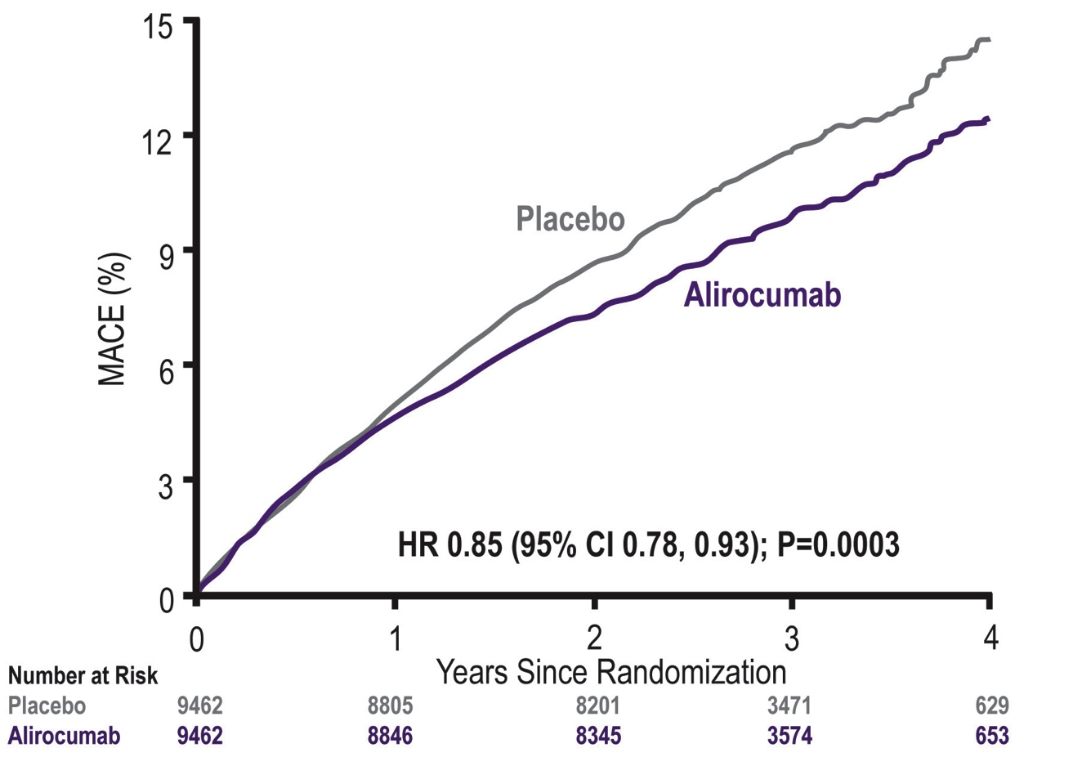
ODYSSEY Outcomes
Primary Efficacy Endpoint: MACE
MACE: CHD death, non-fatal MI, ischemic stroke, or unstable angina requiring hospitalization
ARR* 1.6%
*Based on cumulative incidence
Steg G. et al; On behalf of the ODYSSEY OUTCOMES Investigators and Committees - American College of Cardiology – 67th Scientific Sessions - March 10, 2018
Notes:
Notes

Slide 23
Summary: PCSK9 inhibitor CVOT Data
PCSK9i represent the most effective way of lowering LDL-C in a broad cross-section of patients with clinical cardio-vascular disease or those with familial hypercholesterolemia.
Clinical trials with PCSK9i demonstrate efficacy and safety of LDL-C lowering by an additional 60% on top of statin ± ezetimibe therapy resulting in further reductions in MACE.
The use of PCSK9i is recommended on top of statin therapy in high risk cardio-vascular patients to enable lowering of the LDL-C to recommended levels.
MACE = Major Adverse Cardiovascular Events

Slide 24


Physician and Patient Distribution
n = 2,024 high risk with/for CVD:
on maximally tolerated statin ≥ 3 months
LDL-C ≥ 2 mmol/L
Patients with:
ASCVD: CAD, AAA, PAD, CeVD or
FH
Quebec N=14
n=105
British Columbia
N=21
n=169
Manitoba
N=5
n=49
Nova Scotia
N=1
n=0
Alberta N=13
n=90
Nova Scotia
N=2
n=19
Sask. N=3
n=6
Ontario
N=115
n=1545
New Brunswick
N=5
n=41
N = 248 MDs
Data as of Apr 04, 2019

Slide 25
CVD vs FH
Cardiovascular Disease (53%)
Both CVD and FH (17%)
Familial Hypercholesterolemia (30%)
CVD include CAD, CeVD, AAA, PAD
Overall CVD = 70%, FH = 47%
Data as of Apr 04, 2019

Slide 26
Demographic and Physical Assessment
Age, years* | 63 (55, 71)
Women, % | 42
Caucasian, % | 72
East/South East/South Asian, % | 17
Systolic Blood Pressure, mm Hg* | 128 (120, 138)
Diastolic Blood Pressure, mm Hg* | 78 (70, 82)
Heart rate, beats/minute* | 72 (65, 80)
Weight, kg* | 81 (70, 93)
BMI, kg/m²* | 29 (25, 32)
Iliac Waist Circumference, cm* | 100 (91, 109)
* Median (25th, 75th percentiles)
Data as of Jan 25, 2019

Slide 27
Co-morbidities
Medical History | %
Smoking (past/current) | 48 (34/14)
Coronary Artery Disease (MI or ACS/Angio or Stable/PCI/CABG) | 51 (27/18/24/14)
Cerebrovascular disease (Stroke/TIA/Carotid Sx) | 8 (5/3/<1)
Abdominal Aortic Aneurysm | 2
Peripheral Arterial Disease | 9
Diabetes | 36
Hypertension | 61
Chronic Kidney Disease | 8
Familial Hypercholesterolemia | 48
* Median (25th, 75th percentiles)
Data as of Jan 25, 2019

Slide 28
Lipid Modifying Therapy
 | %
Atorvastatin (10/20/40/80 mg) | 28 (4/5/8/11)
Rosuvastatin (5/10/20/40 mg) | 40 (5/11/12/12)
Pravastatin (10/20/40 mg) | 5 (1/2/2)
Simvastatin (5/10/20/40/80 mg) | 3 (<1/1/<1/1/<1)
Fluvastatin (20/40 mg) | 1 (<1/1)
Lovastatin (20/40 mg) | <1 (<1/<1)
No statin | 24
Ezetimibe | 25
Bile Acid Sequestrant | 5
Fibrate | 3
Niacin | <1
Data as of Jan 25, 2019

Slide 29
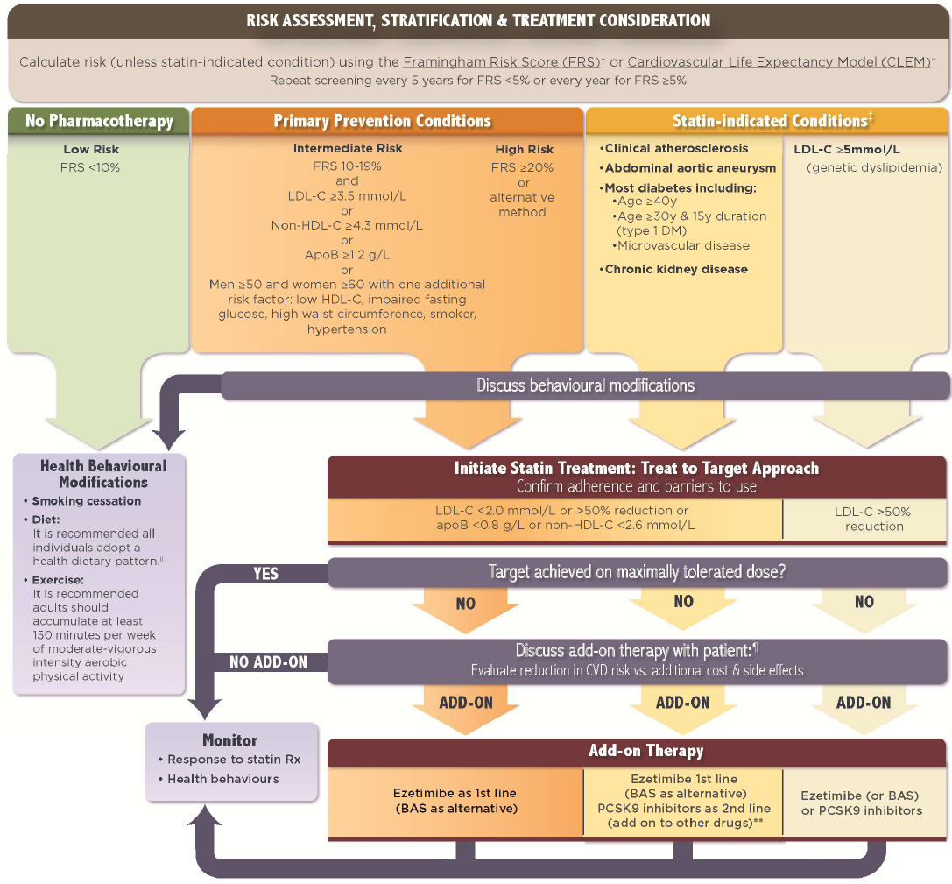

Slide 30
Planned Lipid Modifying Treatment Addition After Visit 1
 | %
Ezetimibe | 28
Bile Acid Sequestrant | 4
PCSK9 Inhibitor | 42
Fibrate | 3
Niacin | 1
Data as of Jan 25, 2019

Slide 31
Reasons why PCSK9 inhibitor not prescribed
Reasons not prescribed reason | PCSK9i % | Ezetimibe %
Co-morbidities | 1.1 | 1.2
Cost | 25.4 | 8.4
Patient intolerant | 1.4 | 0.3
Believe my management is appropriate | 0.3 | 20.8
Patient refused | 25.0 | 32.9
Will provide Rx / prescribe at the next patient visit | 18.9 | 13.7
Social constraints | 0.6 | 0.1
Not needed | 27.3 | 22.5
Data as of Jan 25, 2019

Slide 32
Additional Lipid Modifying Therapy
Visit 1: Baseline (n=1,987)
Visit 2: 6-16 weeks (n=1,372)
Visit 3: 18-30 weeks⁺ (n=1,020)
⁺ ≥6 weeks post Visit 2
% of Patients
Ezetimibe
BAS
Fibrate
Niacin
PCSK9 Inh.
Data as of Jan 25, 2019

Slide 33
% of Patients Achieving LDL-C Target*
* ≤2.0 mmol/L by Canadian Cardiovascular Society Guideline Recommendations
% of Patients
Visit 1
n=1,927
Visit 2
n=1,372
Visit 3
n=1,020
Data as of Jan 25, 2019

Slide 34
Impact of the implementation science:
LDL-C reduction
1 mmol/L ↓ in LDL = 20% ↓ in CV Mortality
LDLC (mmol/L)
GOAL so far: over 200 lives saved
Visit 1
n=2,027
Visit 2
n=1,616
Visit 3
n=1,206
Data as of Apr 18, 2019
Notes:
N=297 used PCK9 currently at V3 vs n=909 not using currently at V3,
For N=297, LDL = 1.48 (1.05) median (IQR) = 1.30 (0.67-1.97)
For N=909, LDL = 2.39 (1.12), median (IQR) = 2.19 (1.66-2.95)

Slide 35
Summary: GOAL Canada
The experience indicates that recommendations may not be followed in many high risk patients.
Quality enhancement research initiative like GOAL International is feasible and results in increased proportion of patients achieving the recommended LDL-C level.

Slide 36
GOAL International
Guidelines Oriented Approach to Lipid lowering International
STEERING COMMITTEE
Anatoly Langer, MD (Chair)
Khalid Al Faraidy, MD (Saudi Arabia)
Mousa Akbar, MD (Kuwait)
4. Wael Almahmeed, MD (Abu Dhabi)
5. Marco Antonio Alcocer-Gamba, MD (Mexico)
6. Otavio Berwanger, MD (Brazil)
COORDINATING CENTRE
Canadian Heart Research Centre, Toronto, Canada
INVESTIGATOR SPONSORED STUDY
Anatoly Langer, MD, M.Sc, FRCP(C,) FACC
 416-999-6264; Fax 866-562-9769
E-mail: langera@chrc.net
SUPPORT Amgen Inc.

Slide 37
GOAL International: Patient Targets
The program population will consist of up to 2,500 study patients enrolled at approximately 115 health care provider (HCP) offices across five regions:
600 pts Saudi Arabia / 30 HCPs
500 pts Kuwait / 25 HCPs
400 pts United Arab Emirates / 20 HCPs
500 pts Mexico /20 HCPs
500 pts Brazil / 20 HCPs

Slide 38
GOAL International: Inclusion Criteria
1. Adults ≥ 18 years old
2. High risk for cardiovascular morbidity and mortality (at least one of the following):
Atherosclerotic Cardiovascular disease
- Coronary Artery Disease (CAD): history of ACS/MI, CABG, PCI, coronary stenosis >50% and stable angina
- Cerebrovascular Disease (CeVD): history of CVA/TIA, carotid surgery
- Abdominal Aortic Aneurysm (AAA): history of surgery/intervention
- Peripheral Arterial Disease (PAD): history of surgery/intervention
Familial hypercholesterolemia
- defined as LDL-C > 5 mmol/L (200 mg/dl or ≥190 mg/dl as per Grundy SM, et al 2018 Cholesterol Clinical Practice Guidelines) prior to lipid lowering therapy and one of:
typical physical findings (stigmata) such as tendon xanthomata, xanthelasma, and arcus corneae
- personal history of early cardiovascular disease
- family history of early cardiovascular disease or of marked hyperlipidemia
3. Receiving optimal (maximal or maximal tolerated) statin therapy for at least 3 months prior to patient enrolment
4. LDL-C within the past 6 months above recommended level according to the most up-to- date Guidelines despite maximally tolerated statin therapy +/- ezetimibe (or other lipid lowering therapy)
5. Desire and ability to participate in the program.

Slide 39
GOAL International: Exclusion Criteria
1. Current treatment with PCSK9 inhibitor
2. Current participation in an investigational study
3. Prior participation in the GOAL program

Slide 40
GOAL International: Timeline
The program started in Q2 of 2019.
The program is expected to close in Q2 2022 with the overall duration of 36 months (6 months start up, 12 months of enrolment and 18 months of follow up).

Slide 41
GOAL International: Timeline

Slide 42
GOAL International: Intervention - 1
Feedback 1: Will be provided if lipid lowering treatment chosen is not consistent with current recommendations:
1) if patient is on optimal statin therapy, addition of ezetimibe or PCSK9i according to the country specific guidelines will be recommended; or
2) if patient is on optimal statin therapy and Ezetimibe, addition of PCSK9i according to the country specific guidelines will be recommended.
Expected possible responses:
a. “Change my management” in which case treatment options will be shown again, or
b. “I would like to continue with my management”. In this case Feedback 2 will be shown.

Slide 43
GOAL International: Intervention - 2
Feedback 2: Will aim to ascertain reasons why physician is not following country specific recommendations?
Expected possible options:
1. Patient Refusal
2. Patient intolerance (this answer implies that treatment was prescribed)
3. Social constraints (e.g. patient is not able to administer the treatment)
4. Medical constraints (co-morbidities)
5. I believe my management is appropriate/ I disagree with the recommendations
6. Cost
If treatment chosen is consistent with recommendations no Feedback will be shown.

Slide 44
GOAL International: Intervention - 3
All treatment decisions are in the best interests of patients as decided by their physician.
All testing (e.g. cholesterol panel) is on the clinical basis.
Management recommendation will focus on the current guidelines

Slide 45
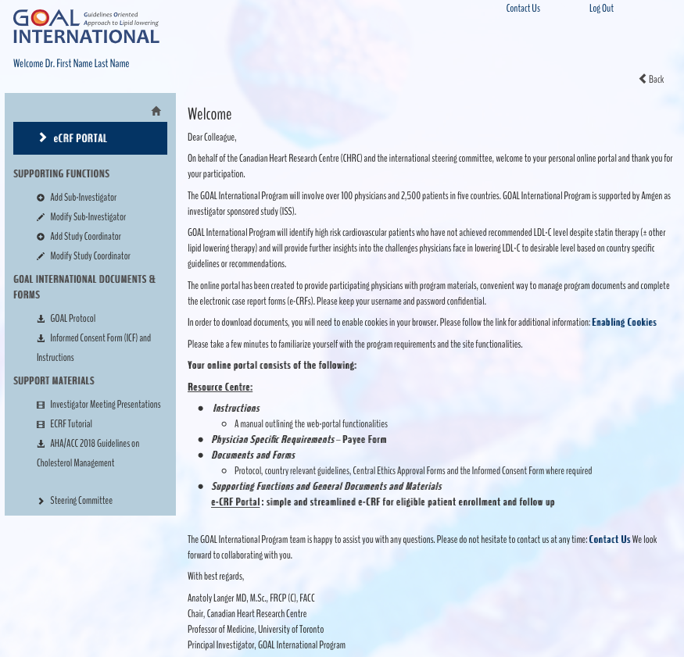
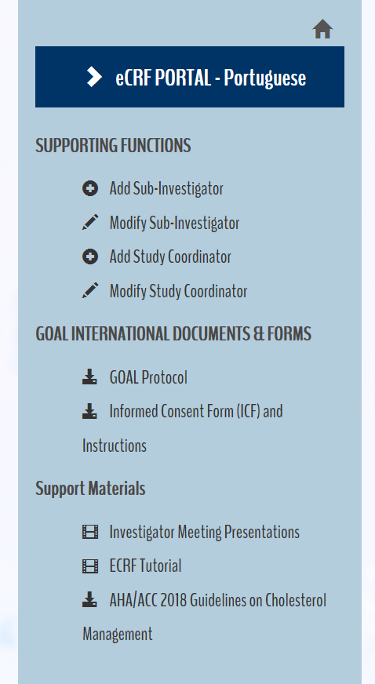
WELCOME PAGE
https://www.goalinternational.info

Slide 46
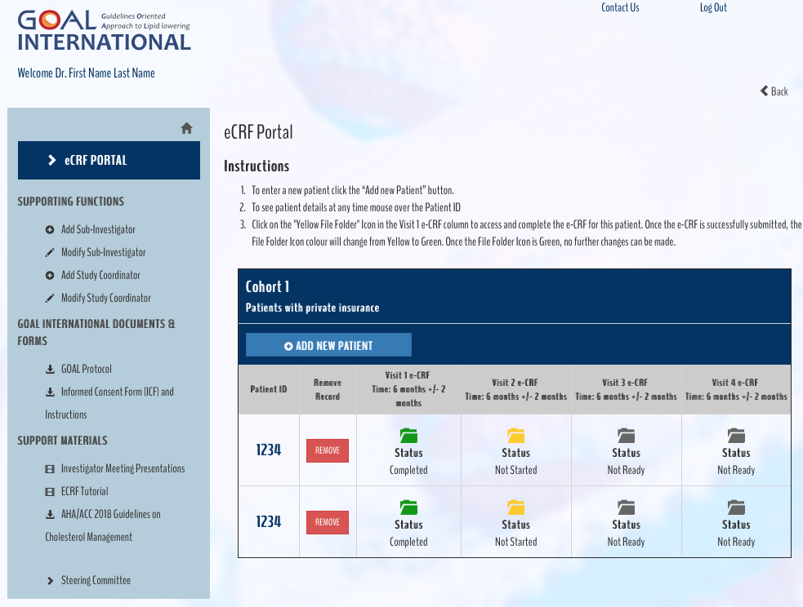
eCRF PORTAL

Slide 47
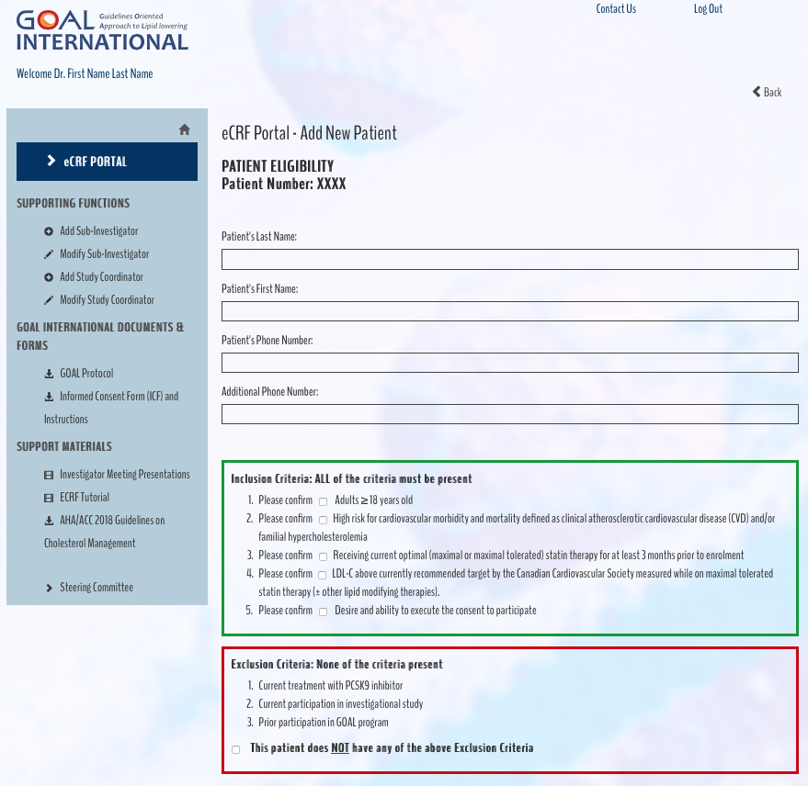
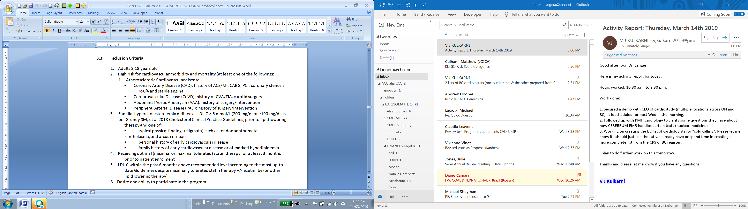
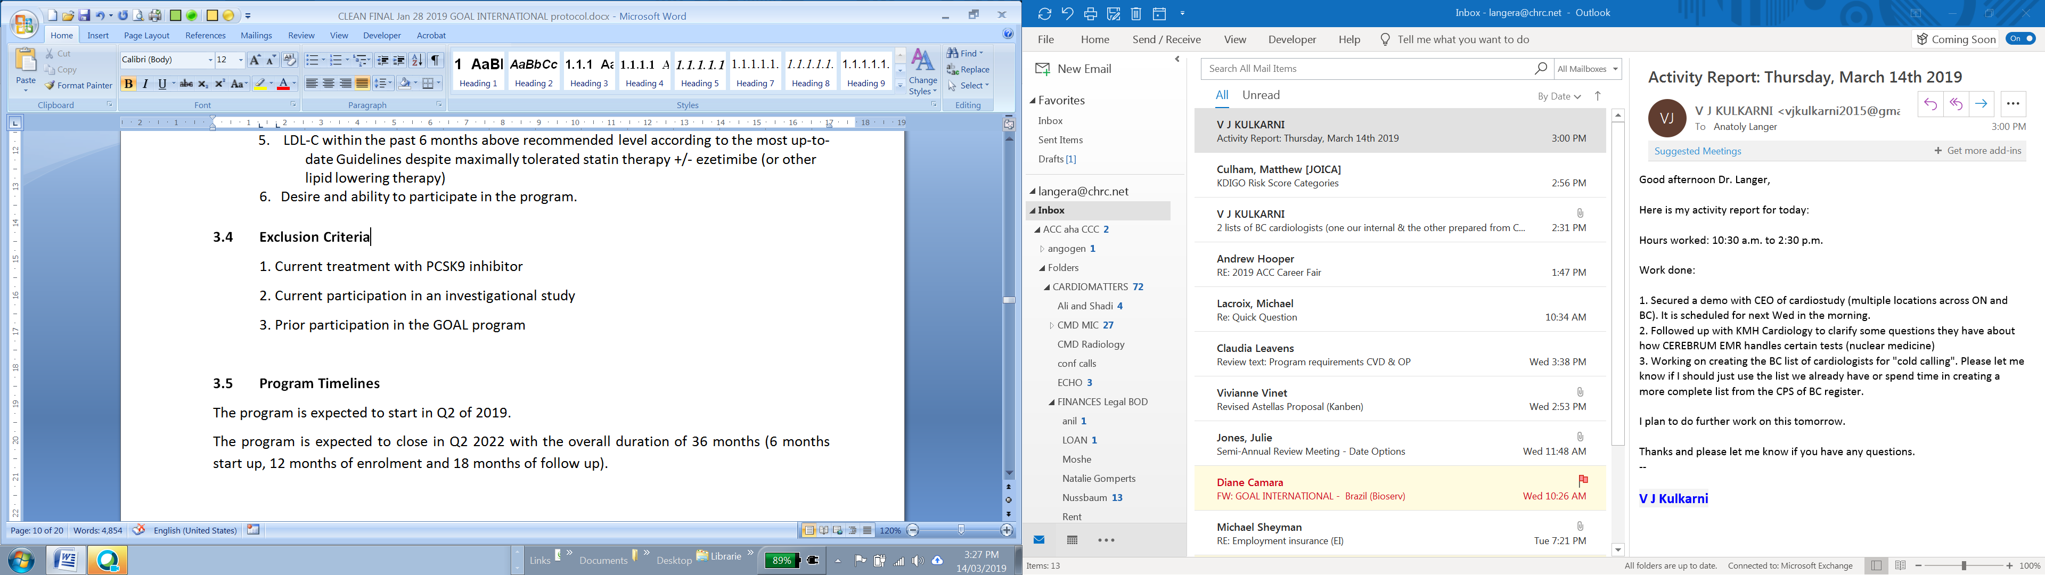

VISIT 1 - Page 1

Slide 48
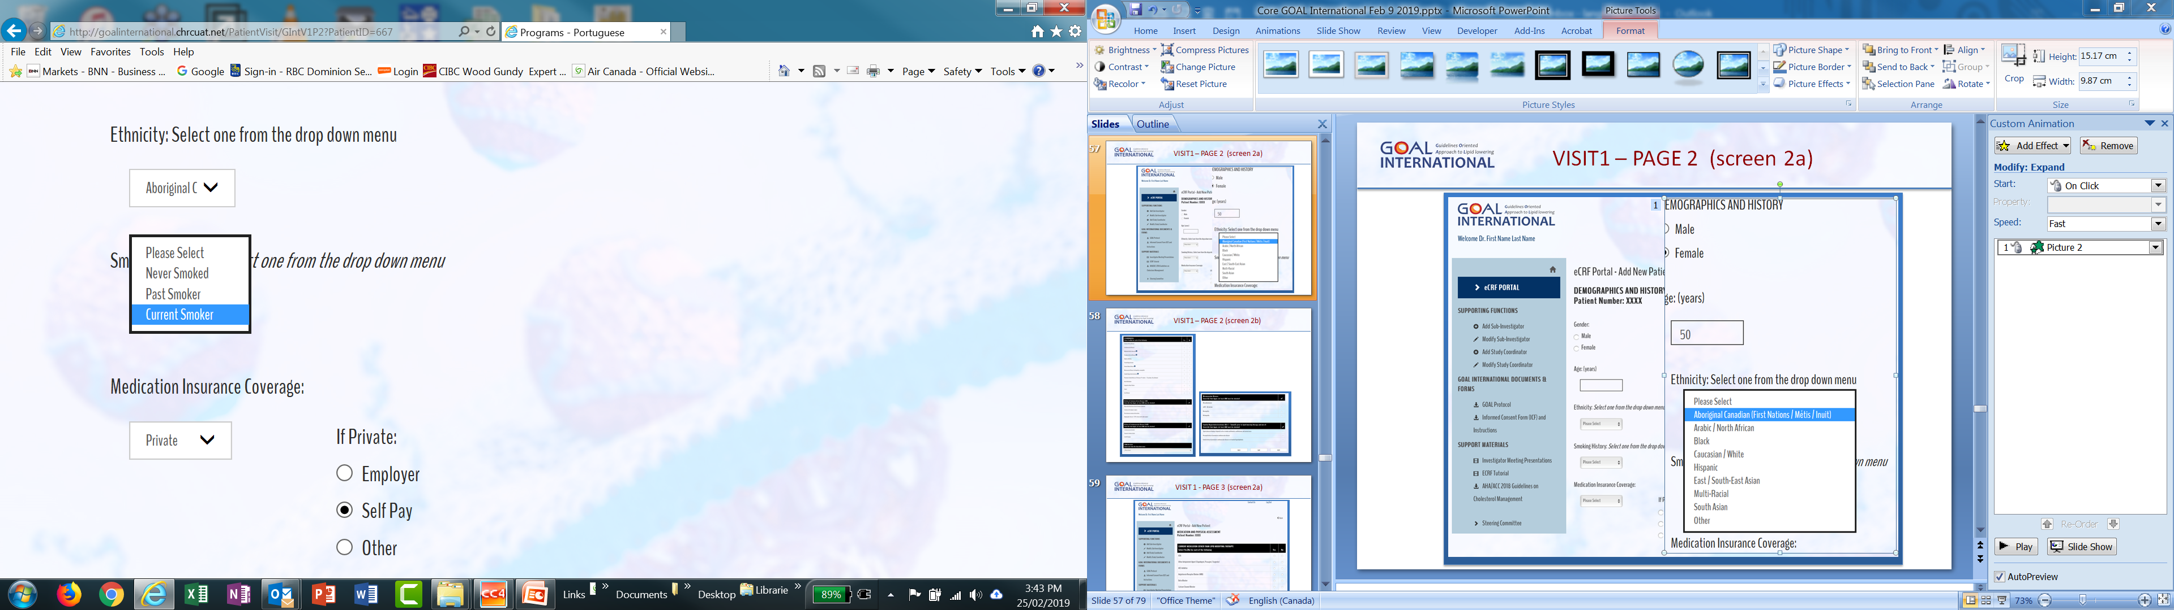
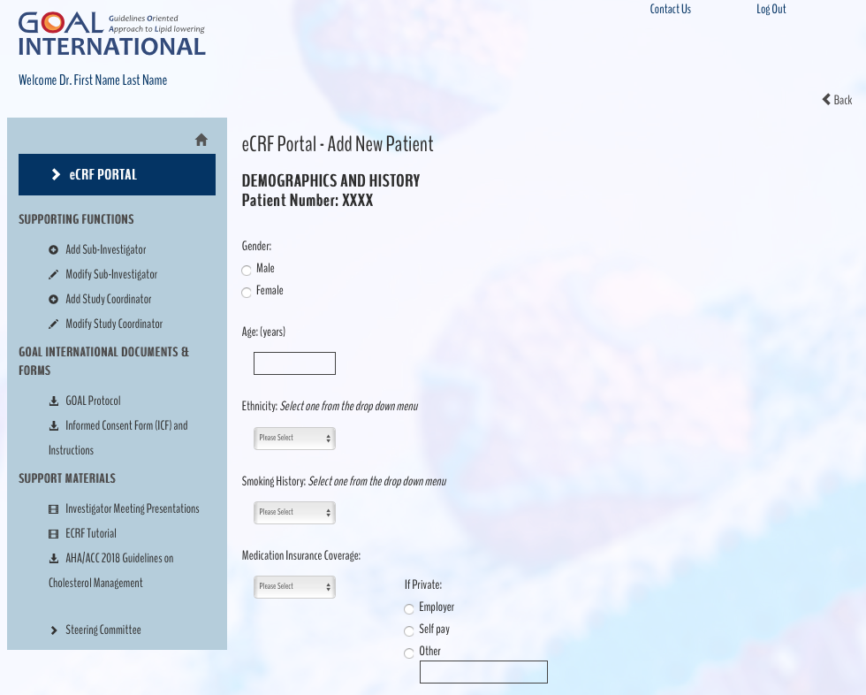
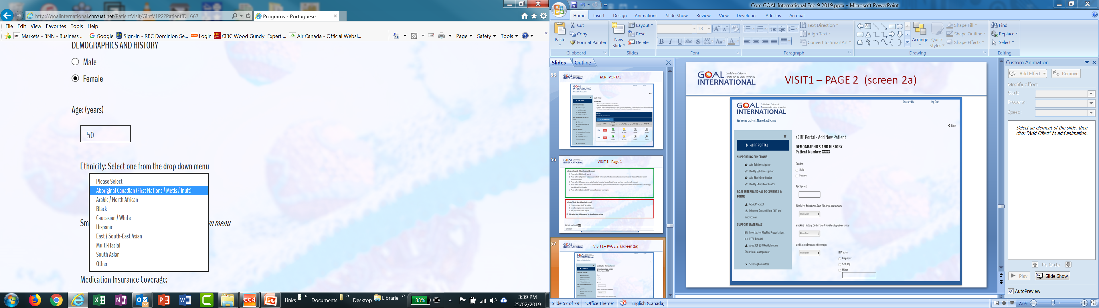
VISIT1 – PAGE 2 (screen 2a)

Slide 49
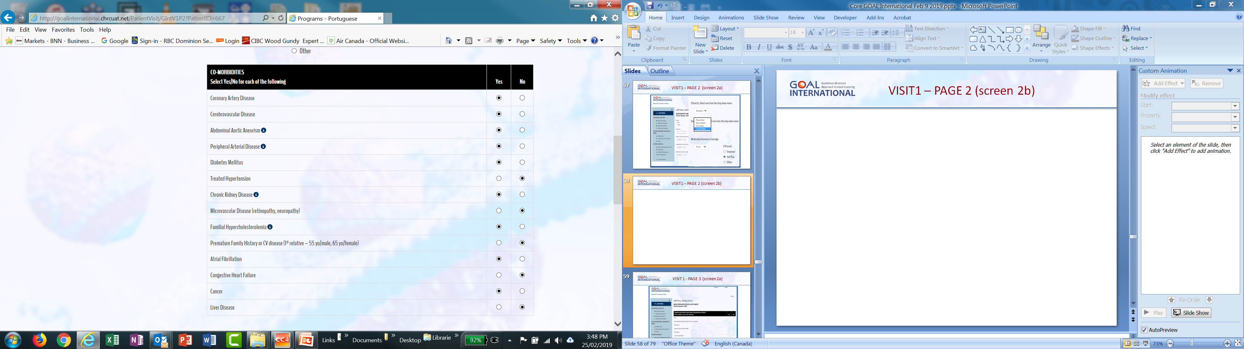
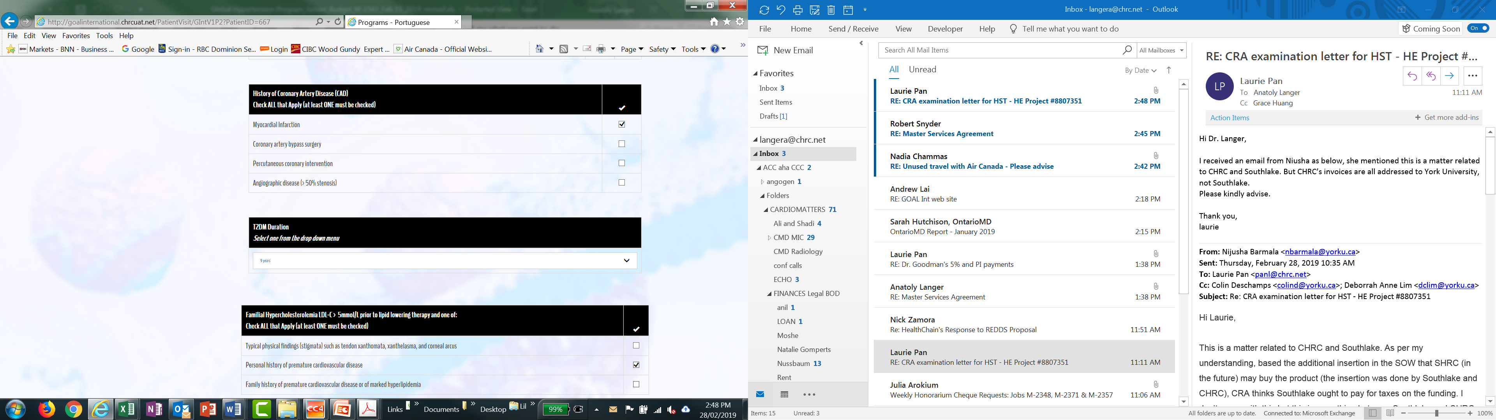
VISIT1 – PAGE 2 (screen 2b)

Slide 50
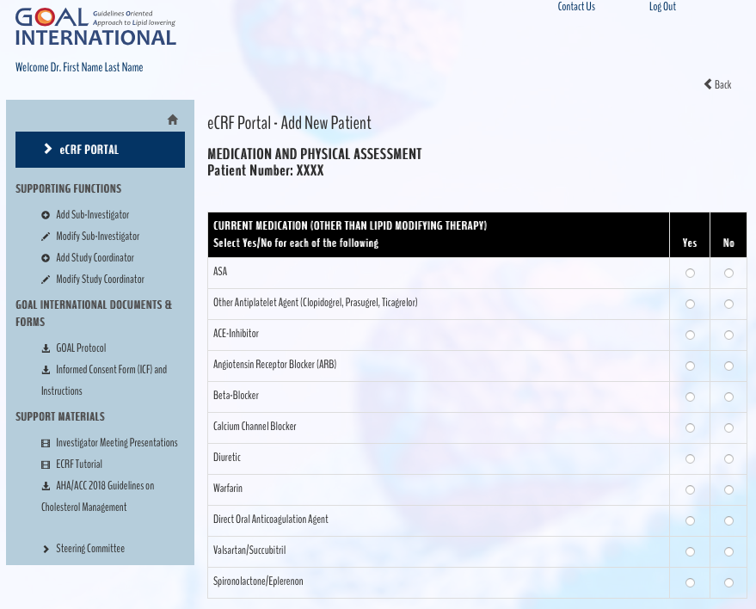
VISIT 1 - PAGE 3 (screen 2a)

Slide 51
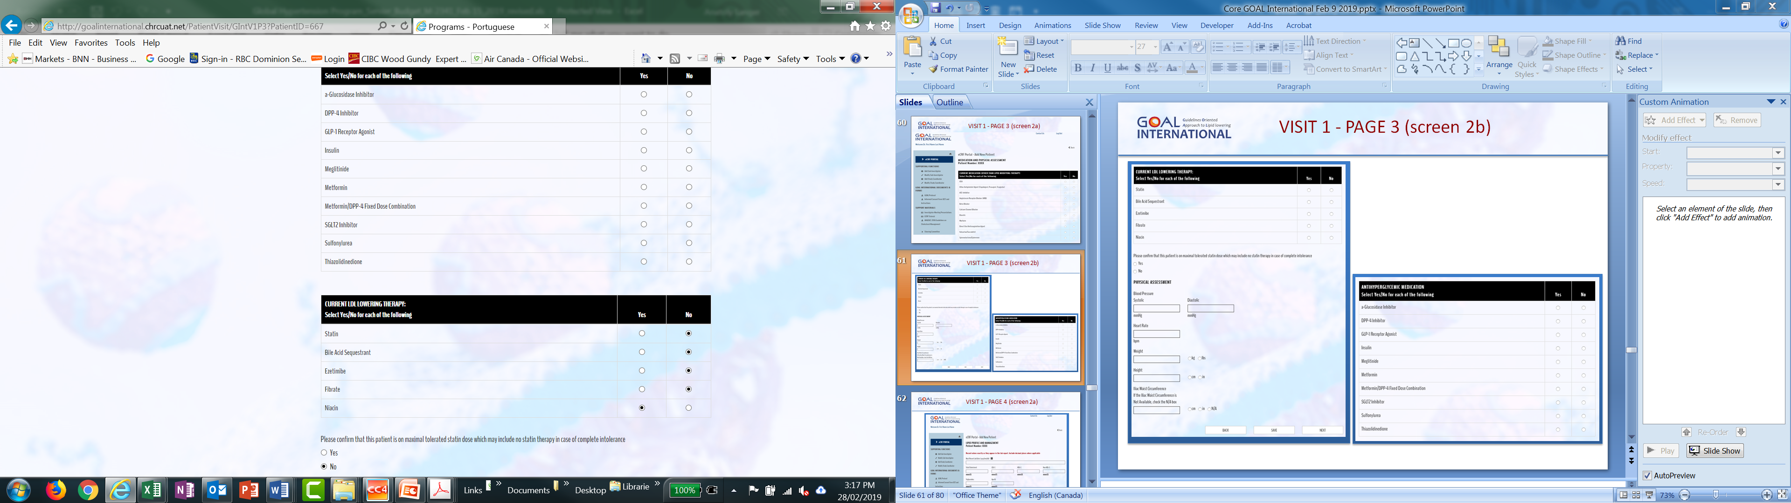
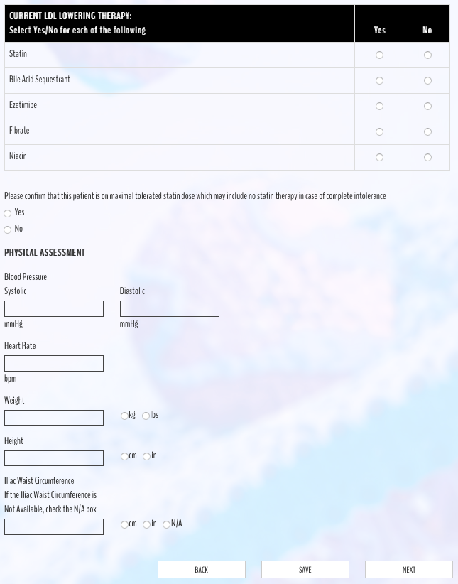
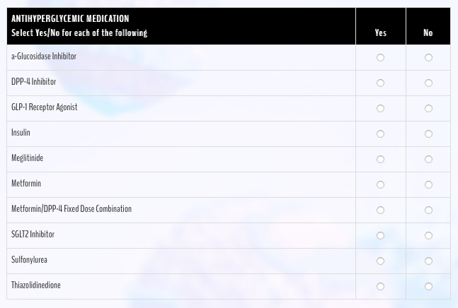
VISIT 1 - PAGE 3 (screen 2b)

Slide 52
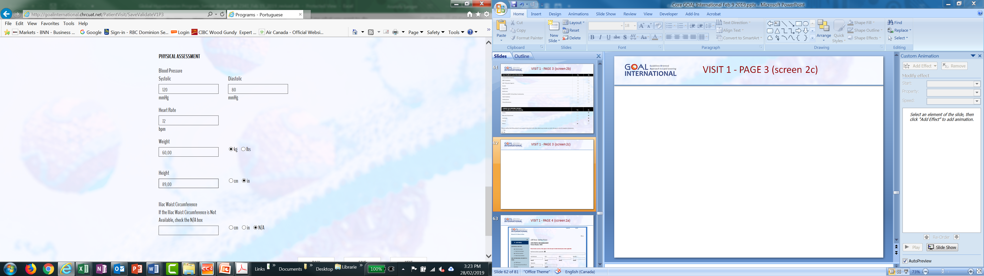
VISIT 1 - PAGE 3 (screen 2c)

Slide 53
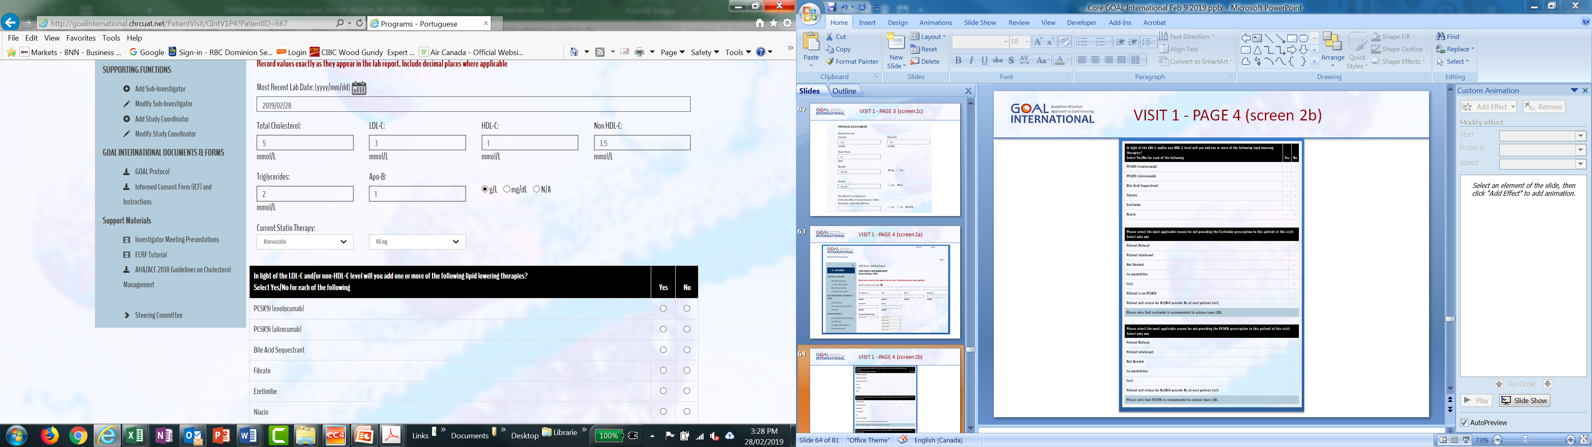
VISIT 1 - PAGE 4 (screen 2a)

Slide 54
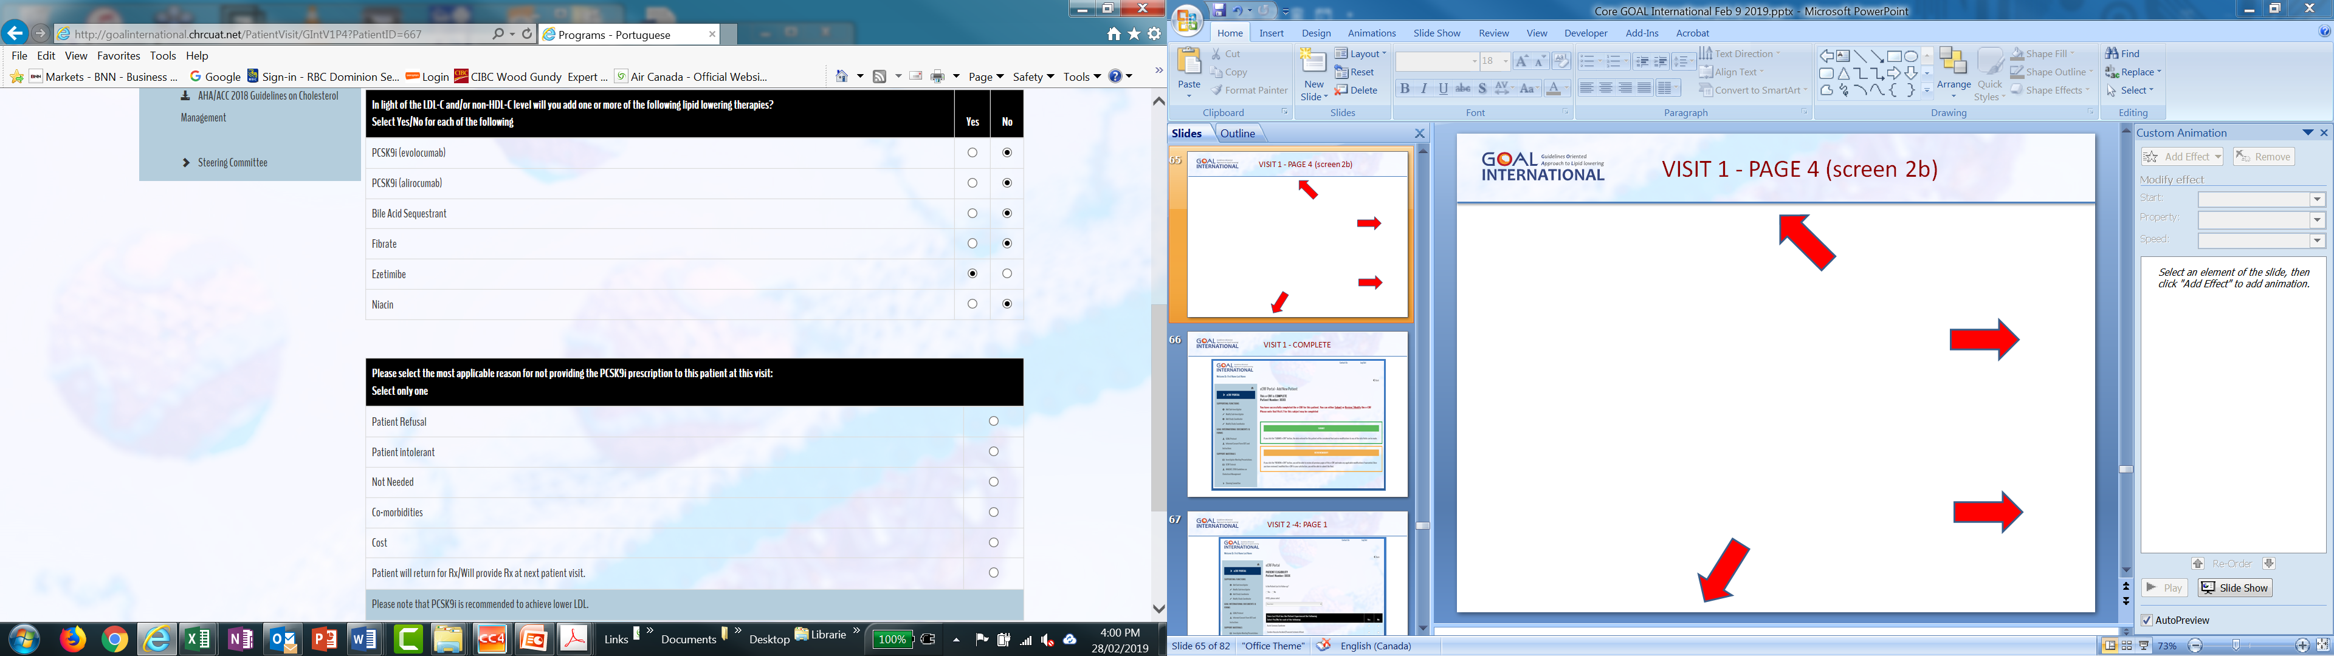
VISIT 1 - PAGE 4 (screen 2c)

Slide 55
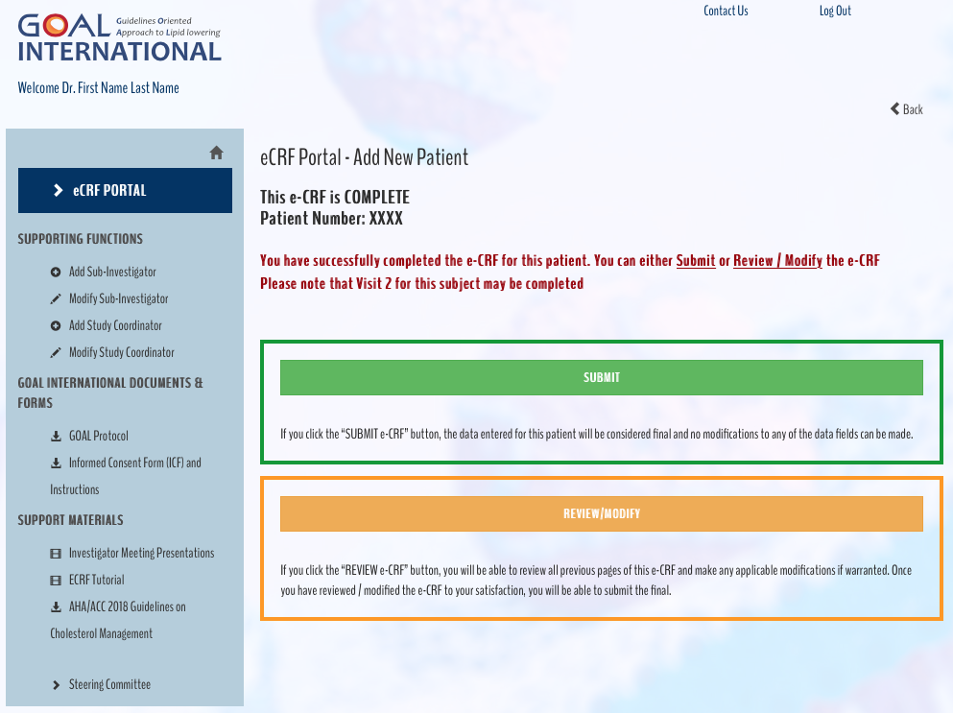
VISIT 1 - COMPLETE

Slide 56
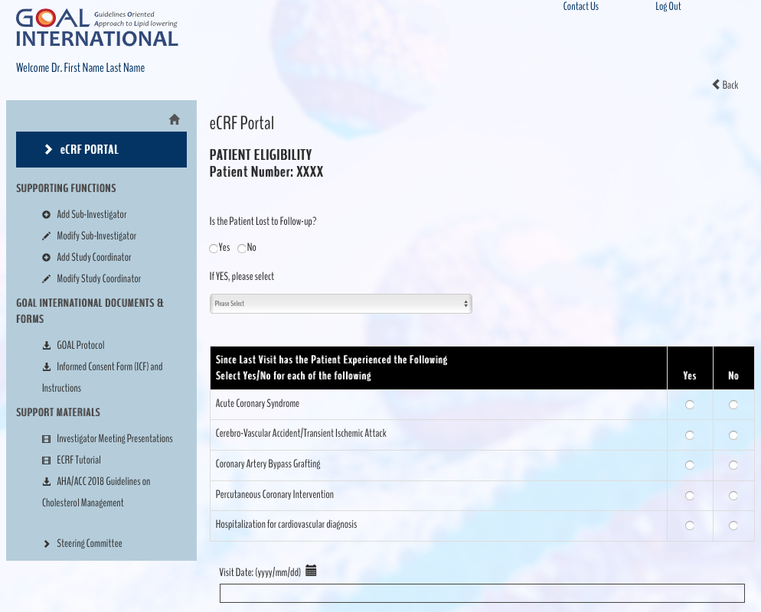
VISIT 2 -4: PAGE 1

Slide 57
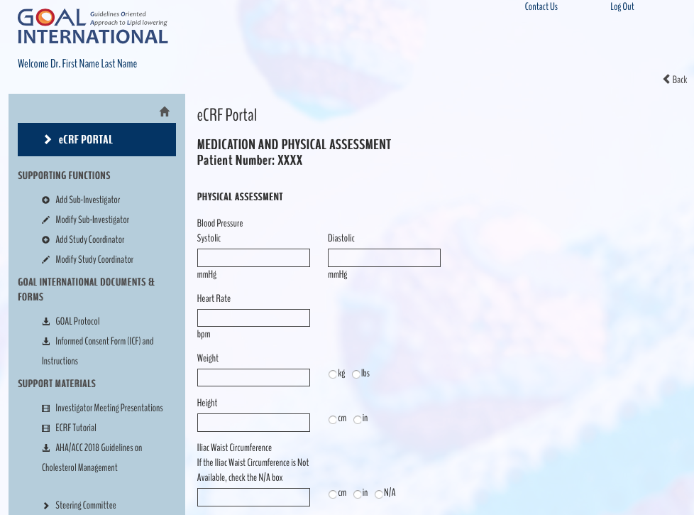
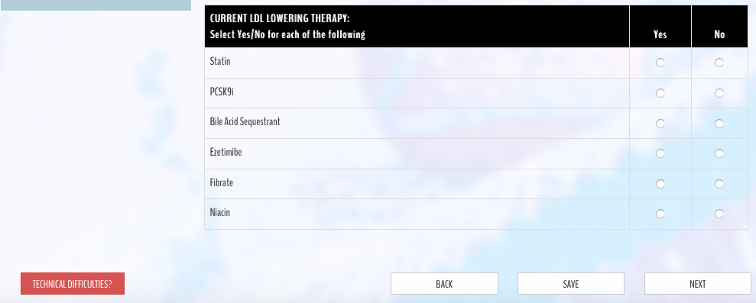
VISIT 2 -4: PAGE 2

Slide 58
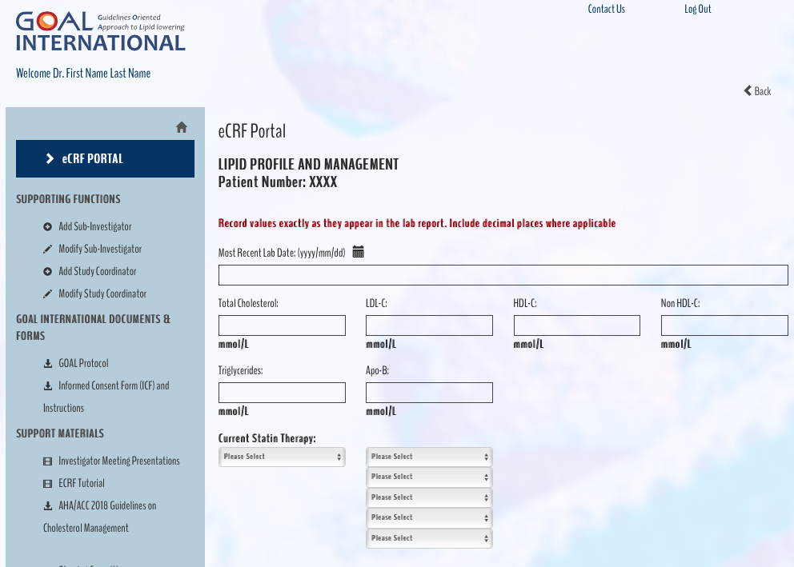
VISIT 2 -4: PAGE 3 (screen 2a)

Slide 59
VISIT 2-4: PAGE 4 (screen 2c)

Slide 60
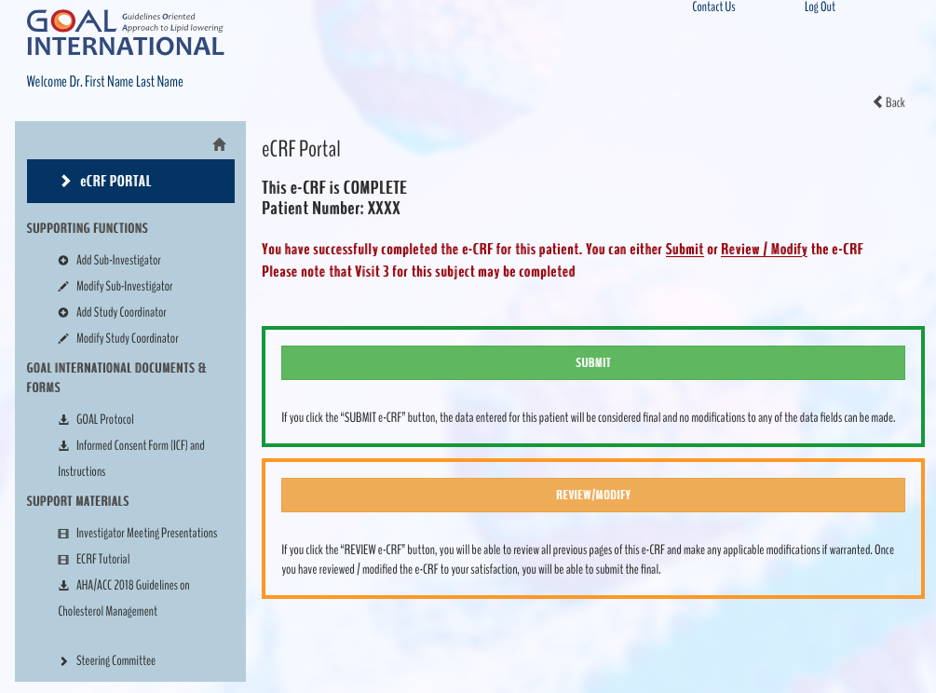
VISIT 2 – 4: COMPLETE

Slide 61
Questions and Discussion
The need for lipid lowering beyond statin therapy
www.goalinternational.info/beyondstatin
The data behind PCSK9 inhibitors
www.goalinternational.info/PCSK9i
Real-world data from the GOAL Canada Program
www.goalinternational.info/goalcanada
GOAL International
www.goalinternational/protocol
www.goalinternational.info/ecrf

